Slide 1
Cards and multi
rows cards
Cards and multi rows cards

Slide 2
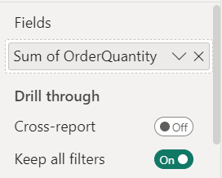
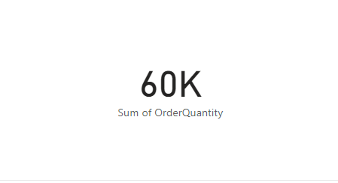
Cards and Multi-Row Cards
Note: This lab uses the AdventureWorksDW2016 database
Add Map From visualization to stage
Add OrderQuantity of FactsInternetField Sales​ setting

Slide 3
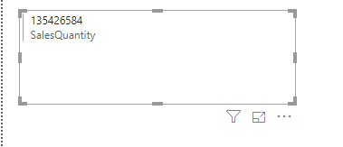
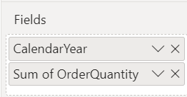
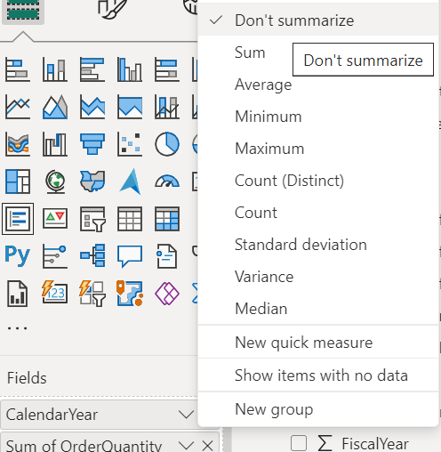
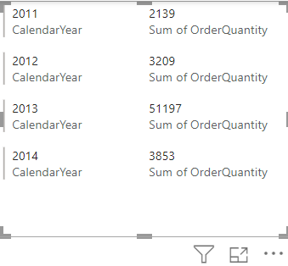
The cards
Change the visualization to MultirowCard on stage now
Add Calendar year from DimDate and disable the summary on it

Slide 4
Thank you
Thank you

